Slide 1
Overview
Timeline
Project Plan
Questions
Notes:
Follow-up Consulting Sessions

Slide 2
Verifly Timeline
Completed
In Progress
Current Timeline and Milestones
Not Started
Jan 7 -11
Jan 14 -18
Jan 21-25
Jan 28 - Feb 1
Feb 4 -8
z
Feb 11 -15
Feb 18-22
Feb 25 - Mar 1
Mar 4 - Mar 8
Mar 11 - Mar 15
Initial Project Setup
Account Setup
Onboarding & Email Preparation
Data Mapping & Automation Testing
API & Integrations
Workflow Development
IP Warmup / Initial Sends
Go Live
User Migration, Third Party Integrations, Data Maintenance
Follow-up Consulting Sessions / Customer Success Troubleshooting
Notes:
Follow-up Consulting Sessions

Slide 3
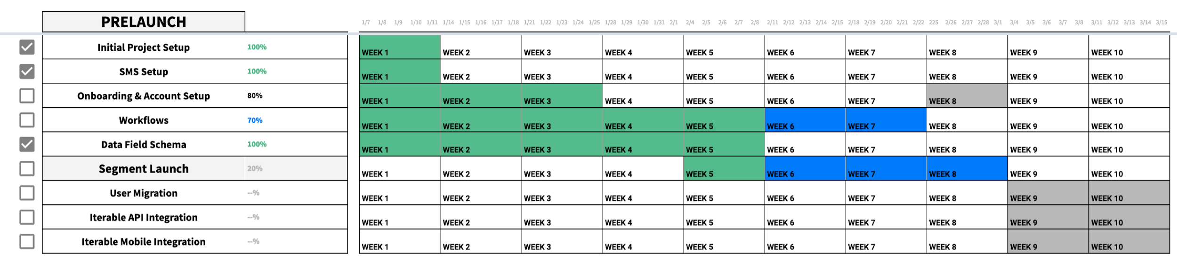
Verifly Timeline
Completed
In Progress
Current Timeline and Milestones
Not Started
Expanded Version
Notes:
Follow-up Consulting Sessions

Slide 4
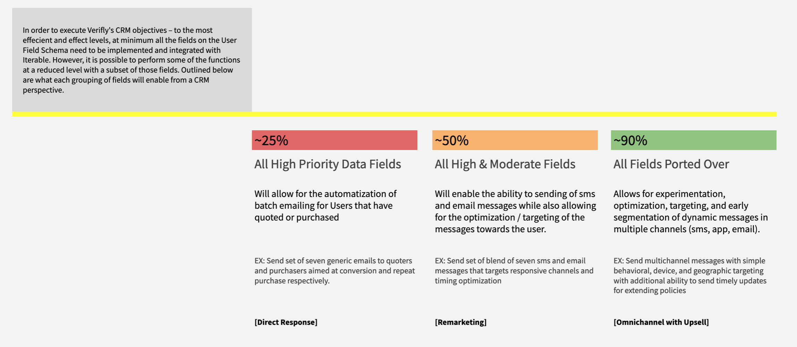
Interim
Expanded Version
Notes:
Follow-up Consulting Sessions

Slide 5
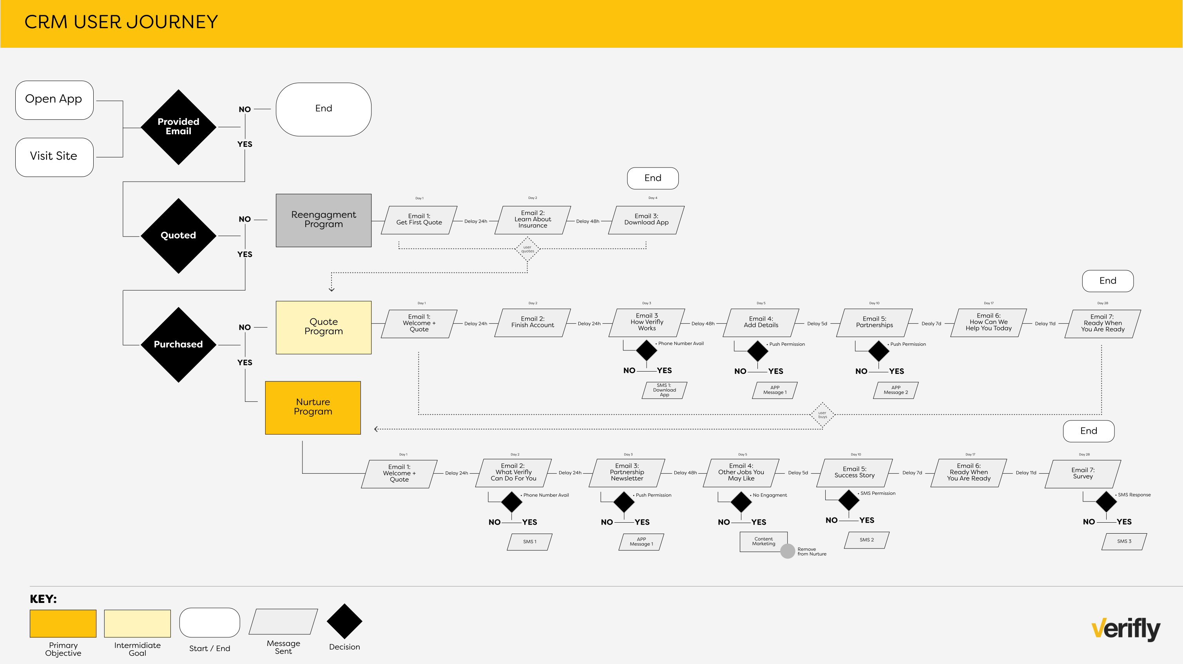
Notes:
Follow-up Consulting Sessions

Slide 6
Go Live
At Launch, all marketing messaging will be sent via Iterable
This Includes:
Quote Journey [Automated]
Customer Journey [Automated]
Marketing Announcements [Manual]
Notes:
Follow-up Consulting Sessions

